Slide 1

Machine Predictive Maintenance Using Machine Learning
Presented by:
P.Sai Kiran
A. Jaswanthi
B. Anjali

Slide 2
CONTENT:
Abstract
Introduction
EDA Process
Machine Learning Algorithms
Applications
Conclusion

Slide 3

ABSTRACT
Machine Predictive Maintenance (PdM) leverages advanced data analytics, machine learning to predict equipment failures before they occur. By continuously monitoring the condition and performance of machinery, PdM enables timely maintenance interventions, reducing unplanned downtime and lowering operational costs. This approach uses sensor data, historical trends, and predictive models to forecast potential issues, enhancing equipment reliability and safety. The integration of real-time analytics and AI-driven diagnostics allows industries to optimize maintenance schedules, increase asset longevity, and minimize disruptions. PdM is revolutionizing industries by shifting from reactive to proactive maintenance strategies.

Slide 4

Introduction
Machine Predictive Maintenance (PdM) is a proactive approach that uses data analysis and monitoring to predict equipment failures before they occur, enabling timely maintenance actions.
The main goal is to reduce unplanned downtime, minimize repair costs, and optimize equipment lifespan by predicting when maintenance should be performed.
PdM utilizes data from various sources like sensors, historical performance records, machine logs, and operational parameters to assess machine health.
Technologies Involved: It relies on advanced technologies like
IoT (Internet of Things) for real-time data collection.
Machine Learning (ML) algorithms for data analysis and prediction.
Big Data Analytics to process large volumes of sensor and operational data.
Cloud Computing for data storage and processing.
AI-based diagnostics for anomaly detection.

Slide 5
Exploratory Data Analysis (EDA) Process
EDA plays a crucial role in predictive maintenance analysis by providing insights into the data and guiding the selection of appropriate machine learning algorithms. This process involves understanding the data's characteristics, identifying trends, and uncovering hidden patterns.
Data Cleaning
Data Cleaning involves removing outliers, handling missing values, and correcting inconsistencies to ensure data quality.
Data Visualization
Visualizing data helps to understand the distribution of variables, identify relationships, and gain insights into the underlying patterns.
Feature Engineering
Creating new features from existing ones can improve the model’s accuracy by extracting relevant information and reducing dimensionality.

Slide 6
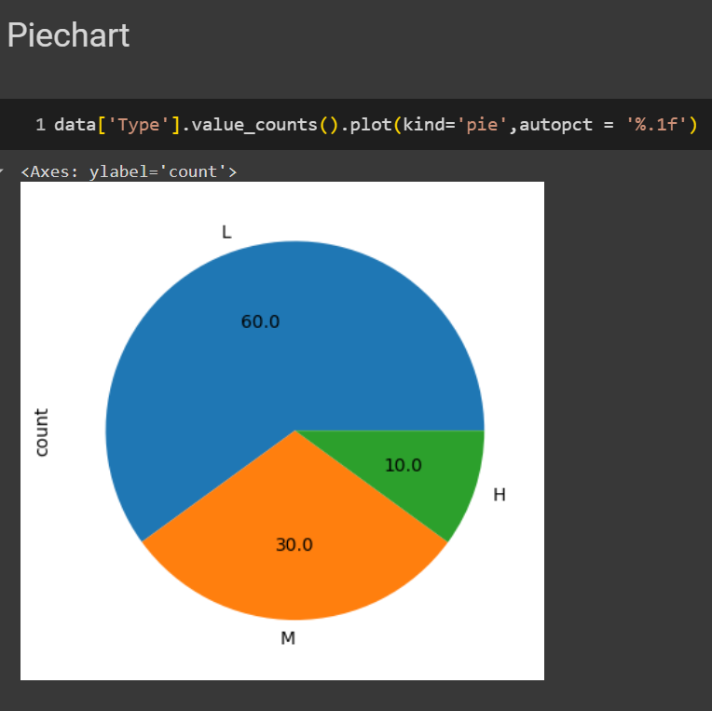
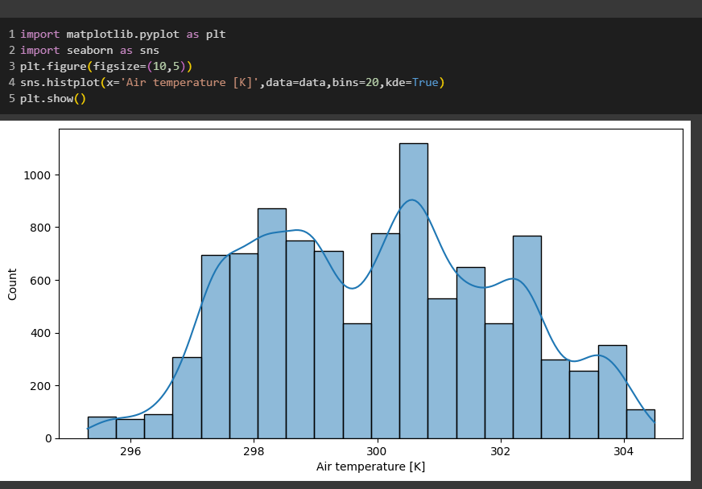
Data Visualization Showing the Type feature count Histplot showing the relation of air temperature with count

Slide 7
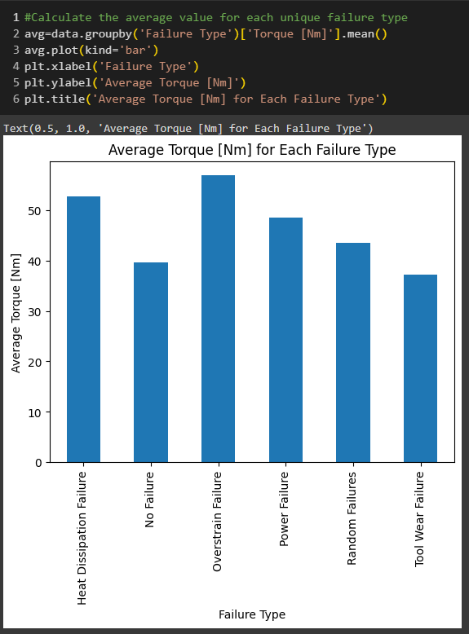
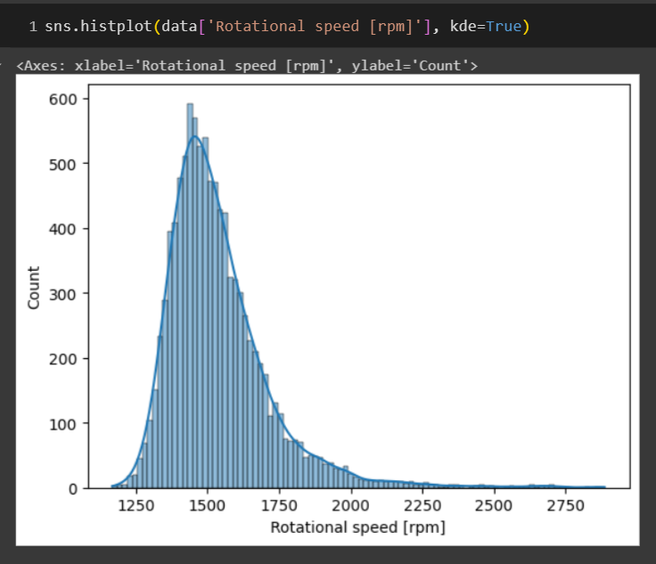
Bar plot showing the average value for each unique failure type Histplot showing relational speed count

Slide 8
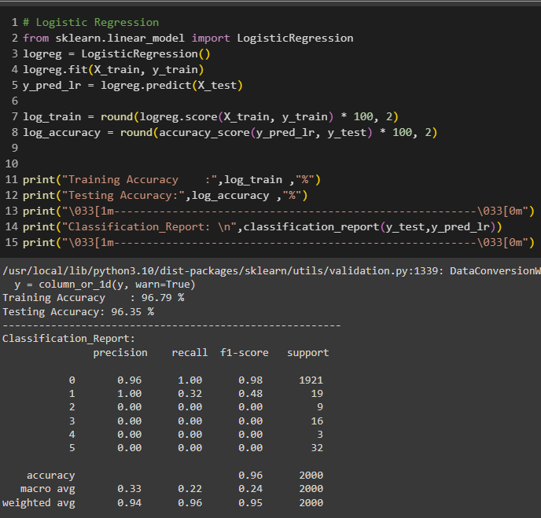
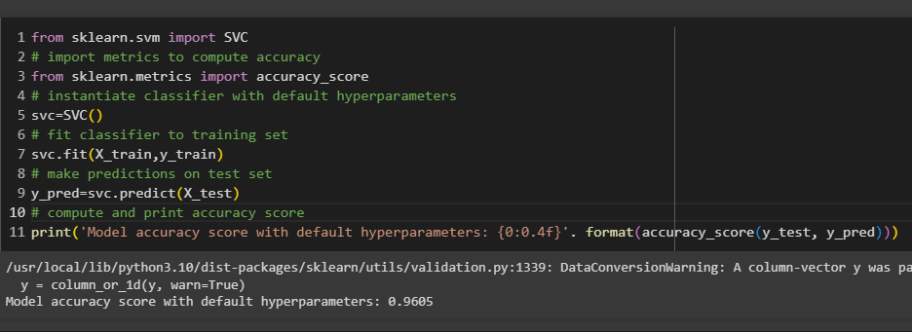
Machine Learning Algorithms
Logistic Regression with 96% accuracy Support Vector Machine with 96% accuracy

Slide 9
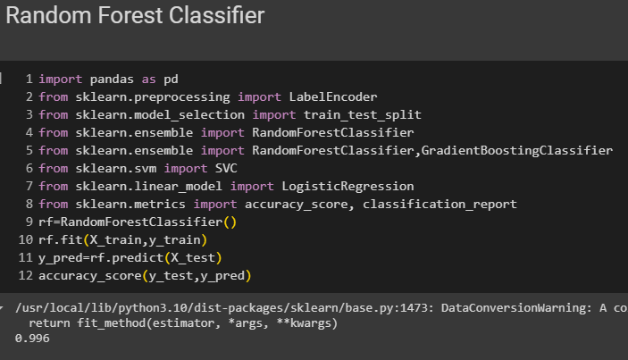
Random Forest Algorithm with 99% accuracy

Slide 10
Application
Benfits :
Manufacturing Equipment Monitoring: Predictive models can anticipate failures in industrial machines by analyzing historical data, preventing costly breakdowns and downtime.
Automotive Maintenance: Machine learning models can predict when vehicle components, like engines or brakes, are likely to fail, helping with timely maintenance.
Energy Sector (Wind Turbines, Solar Panels): Predictive maintenance helps in optimizing performance by predicting failures in renewable energy systems before they occur.
Aerospace Industry: Predictive maintenance algorithms are used to predict failures in aircraft systems, ensuring safety and reducing unplanned repairs.
Smart Grids: In electrical grids, predictive maintenance models can help forecast when critical infrastructure might fail, improving energy distribution reliability.
Future Trends:
Integration with digital twins for enhanced simulations.
Increasing use of edge computing to perform analytics closer to the data source.
Greater adoption of AI and Deep Learning for complex, real-time predictions.

Slide 11
conclusion
The implementation of machine learning algorithms for predictive maintenance is a transformative approach to equipment and system management. By leveraging advanced data analytics, machine learning models can predict equipment failures before they occur, allowing organizations to optimize maintenance schedules, reduce operational downtime, and improve overall efficiency.
Throughout this project, the application of various machine learning algorithms, such as regression models, decision trees, random forests, support vector machines (SVMs) has demonstrated significant benefits in identifying patterns and trends in operational data. These models, when trained on historical and real-time sensor data, provide accurate predictions of when machinery and equipment are likely to fail. This allows for proactive maintenance rather than reactive repairs, reducing both costs and risks associated with unplanned outages.

Slide 12
THANK You

